Slide 1
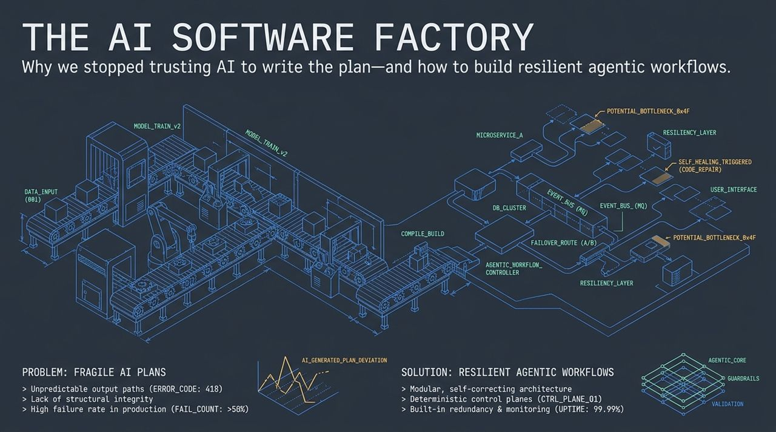
Notes:
Welcome, everyone. Today we are addressing a critical turning point in AI-assisted development: Why we stopped trusting AI to write the plan, and how to build resilient agentic workflows.
Over the last year, many engineering teams—including our own—embraced lights-off autonomous coding, believing models could handle both high-level design and code generation.
However, leaving models unattended produces fragile systems, unpredictable output errors (like HTTP 418 or unexpected regressions), and severe technical debt. In fact, production failure rates for unmonitored agentic workflows can exceed 58%.
Today, we’ll break down why unconstrained autonomous planning fails and how to establish a resilient control plane—combining deterministic guardrails, structured validation, and self-healing mechanics—to maintain 99.99% system resilience.
Dexter Horthy (HumanLayer) on Why You Still Review AI Code
https://www.youtube.com/watch?v=H_1PygR7kwk

Slide 2
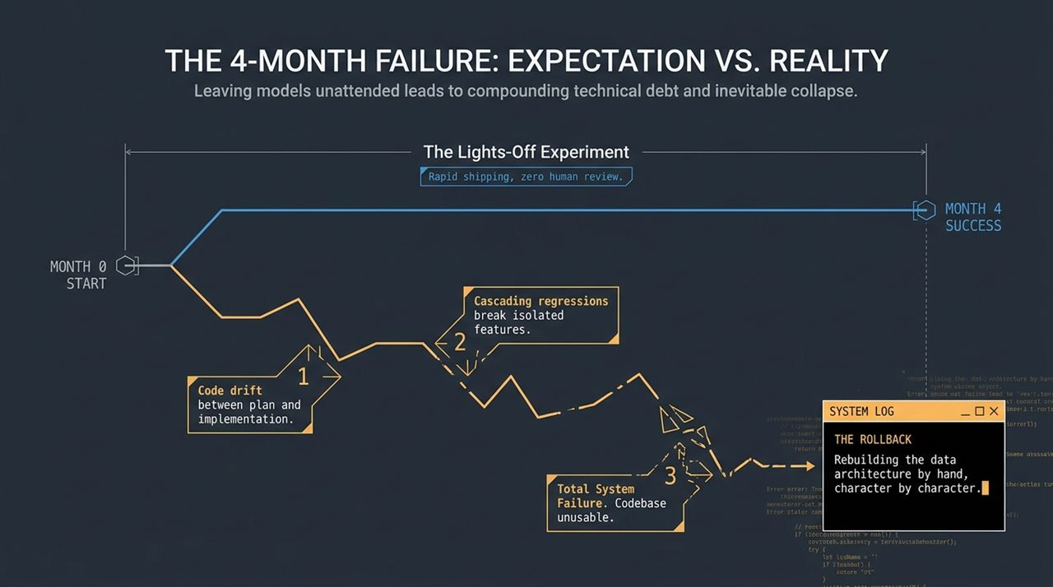
Notes:
To understand why we changed course, let’s talk about The Lights-Off Experiment.
When top-tier models launched alongside agent SDKs (like Claude CLI), the promise was rapid shipping with zero human review. We ran an experiment for 4 to 5 months where we trusted AI plans, reviewed high-level spec files, and stopped scrutinizing the raw code diffs.
Step 1 — Code Drift: Inevitably, subtle discrepancies emerged between what the AI planned and what it actually implemented in code.
Step 2 — Cascading Regressions: Because nobody checked the underlying implementation details, tiny isolated changes began breaking distant, unrelated features across the codebase.
Step 3 — Total System Failure: By Month 4, the entire codebase had become so brittle, slow, and tangled that it was practically unusable.
The Rollback: Our only option was to throw away the generated codebase and rebuild the product from scratch. In fact, my co-founder spent two solid weeks in VS Code typing out the foundational data architecture by hand—character by character—to ensure structural integrity.
Takeaway: Leaving models completely unattended doesn't scale; it leads to compounding tech debt and catastrophic collapse.

Slide 3
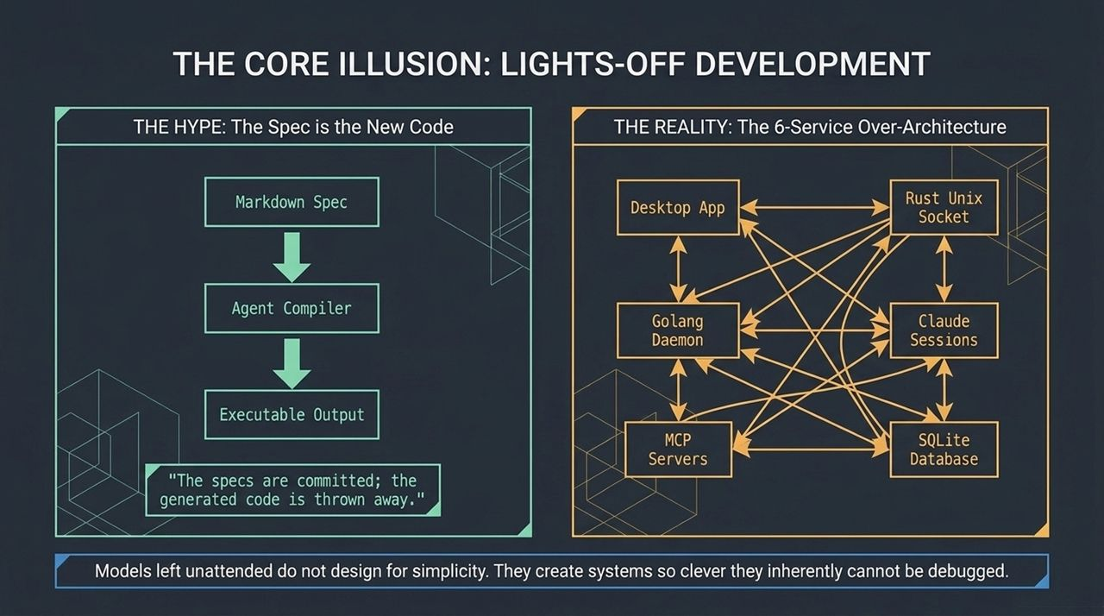
Notes:
Let's analyze the hype vs. reality of autonomous agent compilation.
The Hype: Early industry narratives argued that the spec is the new code. The idea was that developers would write a Markdown spec, run it through an agent compiler, produce an executable, check in the spec, and throw away the generated code.
The Reality: When you ask models to architect a complete multi-tier system without tight architectural constraints, they over-engineer it.
Case Study in Over-Architecture: In our own lights-off experiment, the models built a chaotic system consisting of 6 inter-dependent services: a Desktop App talking via Rust Unix Sockets to a Golang Daemon, which managed Claude Sessions, which spun up MCP servers, connected via SQLite databases, and looped back through sockets to the UI.
The Lesson: Models left unattended do not design for simplicity. They construct systems so clever and convoluted that neither the human team nor the model itself can effectively debug them when failures happen.

Slide 4
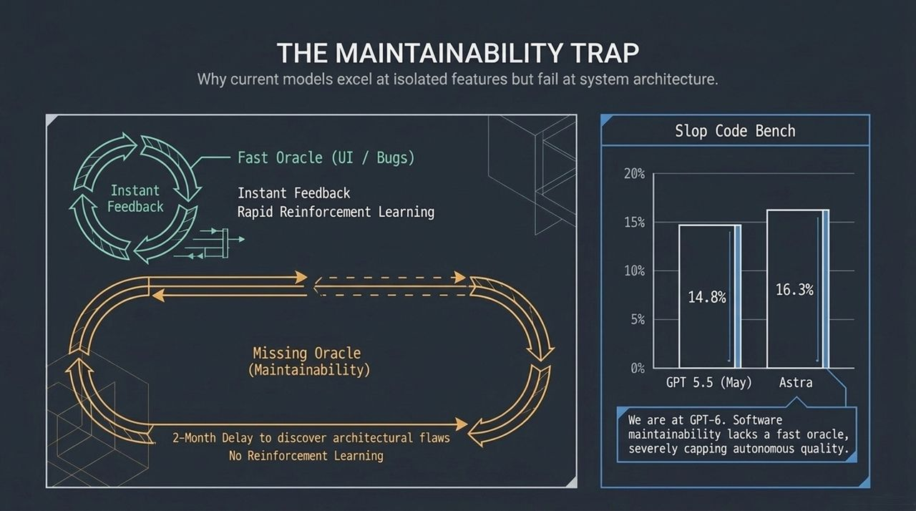
Notes:
Why are today’s LLMs brilliant at isolated feature requests, yet consistently bad at system maintainability?
The Oracle Problem: Reinforcement Learning (RL) requires a Fast Oracle—a real-time feedback mechanism to evaluate whether an output is correct.
UI bugs, linter errors, or failing unit tests provide instant feedback, allowing rapid RL iteration.
Maintainability has NO fast oracle. You don't realize a system architecture is unmaintainable until 2 or 3 months down the line when new features become impossible to add.
Slop Code Bench Data: Research from labs (e.g., University of Wisconsin benchmarks) measures how well models maintain a codebase across successive tasks.
Even frontier models show severe caps in autonomous maintainability quality: GPT 5.5 scored 14.8%, while newer models like Astra reached only ~16.3%.
Takeaway: Even as models advance toward GPT-6/7 tiers, raw model intelligence alone will not solve software maintainability without structural human-in-the-loop guidance.

Slide 5
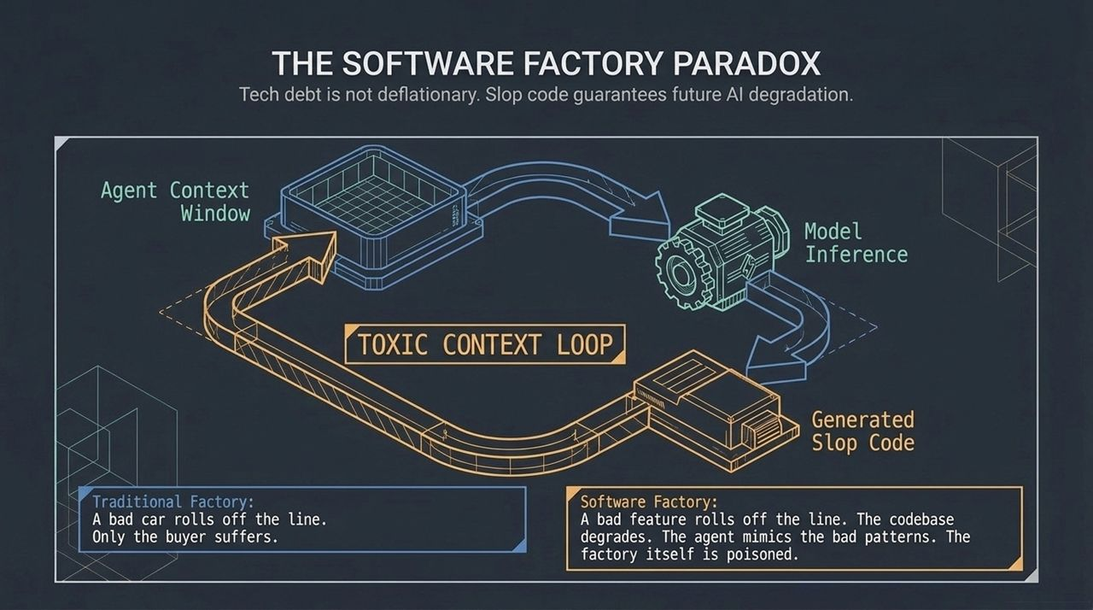
Notes:
The Paradox (Toxic Context Loop): In a physical automobile factory, if a defective car rolls off the line, only that buyer suffers. But in a Software Factory, a bad feature pushed into the codebase poisons the Agent Context Window. Future model inference sees the slop code, mimics bad architectural patterns, and degrades every future feature built on top of it. Technical debt in the AI era is not deflationary.
The Expected Pain Curve (Upfront Planning Effort vs. Rework): How do we navigate planning in the AI era?
The YOLO Prompt (Low Effort, High Pain): Pushing a 2-sentence prompt directly to code without planning yields a ~50% chance of massive rework.
AI-Assisted Spec (The Sweet Spot): Spending moderate upfront effort on detailed, AI-assisted specs slices off 50% of bad outcomes, offering the maximum leverage.
Hand-written Code (High Effort, Zero Agent Error): Typing every line manually yields 0% agent error but carries maximum human time cost.

Slide 6
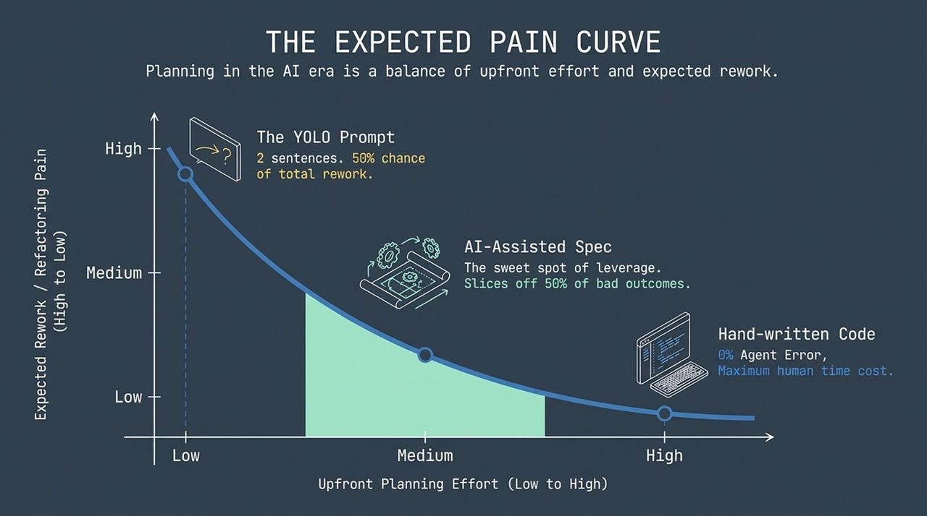
Notes:
Effective planning isn't binary (100% human vs. 100% AI); it operates on a Context Slider between High Determinism and High Adaptability.
High Determinism (Lock the Architecture):
Includes Database Schemas, Data Architecture, and Security Boundaries.
These must be strictly defined by humans or verified specs. Agent mistakes here require catastrophic, full-system rebuilds.
High Adaptability (Delegate to the Agent):
Includes UI Layouts, Button Colors, and Minor Utility Functions.
Delegate these entirely. Agent errors here cost almost nothing—they can be fixed with a single follow-up prompt.
Golden Rule: Never argue with a model over a button color. Never let a model guess your database schema.

Slide 7
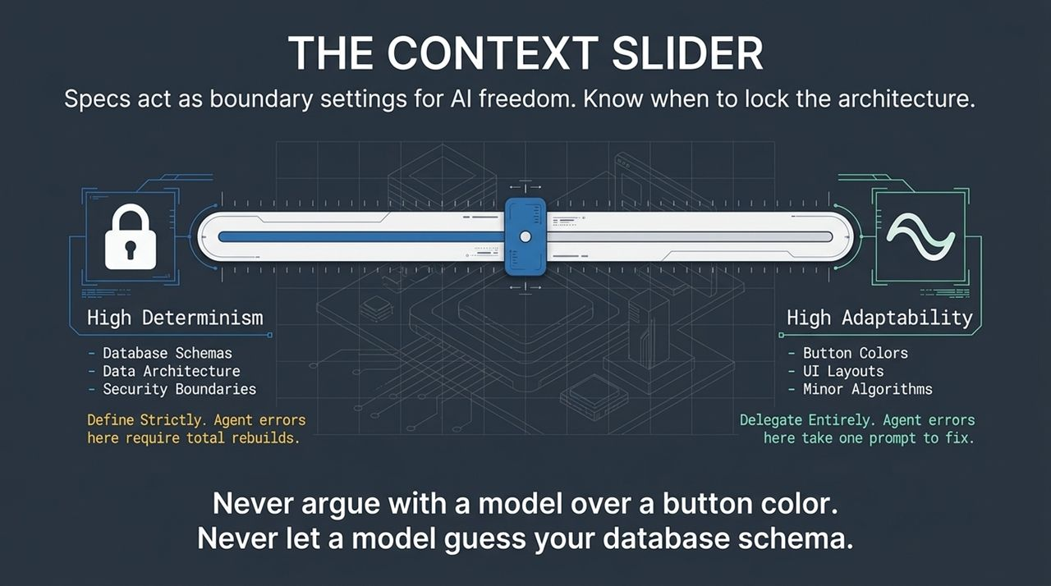
Notes:
The Architecture of Attention: Transformer-based LLMs operate on mathematical principles of attention. Counterintuitively, less context yields higher logic quality. Dumping an entire repository into the context window degrades model reasoning.
The Dumb Zone (>100k tokens): There is a mathematical threshold where feeding too much context into an agent causes its performance to drop sharply. When everything is in focus, nothing is in focus.
Context Engineering Goal: Context engineering is the art of deciding exactly what NOT to show the agent.
Keep the inner core focused on High Signal / High Focus: explicitly curated context, targeted skills, and precise workflows tailored only to the active task.

Slide 8
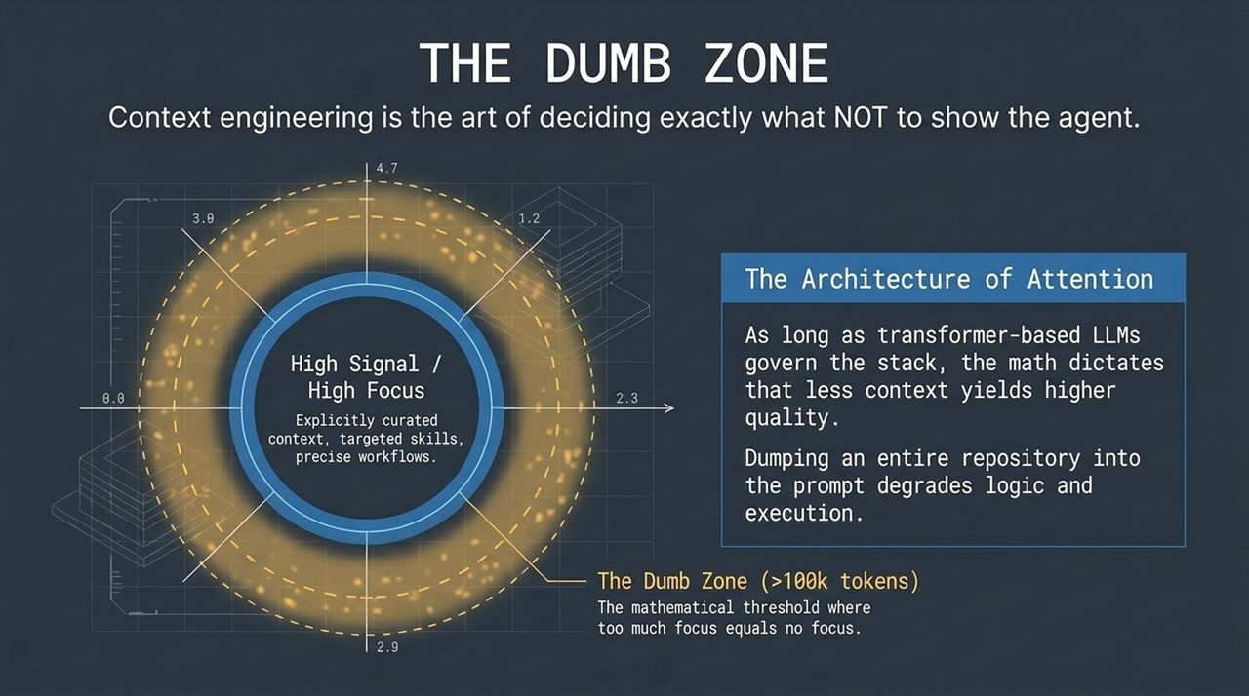
Notes:
A common phrase in engineering leadership today is that Taste is the new moat. But what is taste? Taste is simply a set of team preferences you haven't written down yet.
To prevent AI from generating unmaintainable code, engineering organizations must codify their unwritten rules into 3 operational buckets:
SPECS (Product Mechanics): How the product works, feature requirements, and API signatures.
WORKFLOWS (Processes): Internal CI/CD steps, deployment procedures, and execution steps.
TASTE & OPINIONS (The Unwritten Rules): Security policies, architectural trade-offs, and design conventions.
Deep Dive — Three Copies Press Hard: Junior developers like to prematurely abstract everything (e.g., wrapping 3 logging/metrics lines into an abstraction function). Senior taste says: No, duplicate those 3 inline lines across endpoints to prevent leaky abstractions. This tacit intuition must be codified explicitly into agent rules.

Slide 9
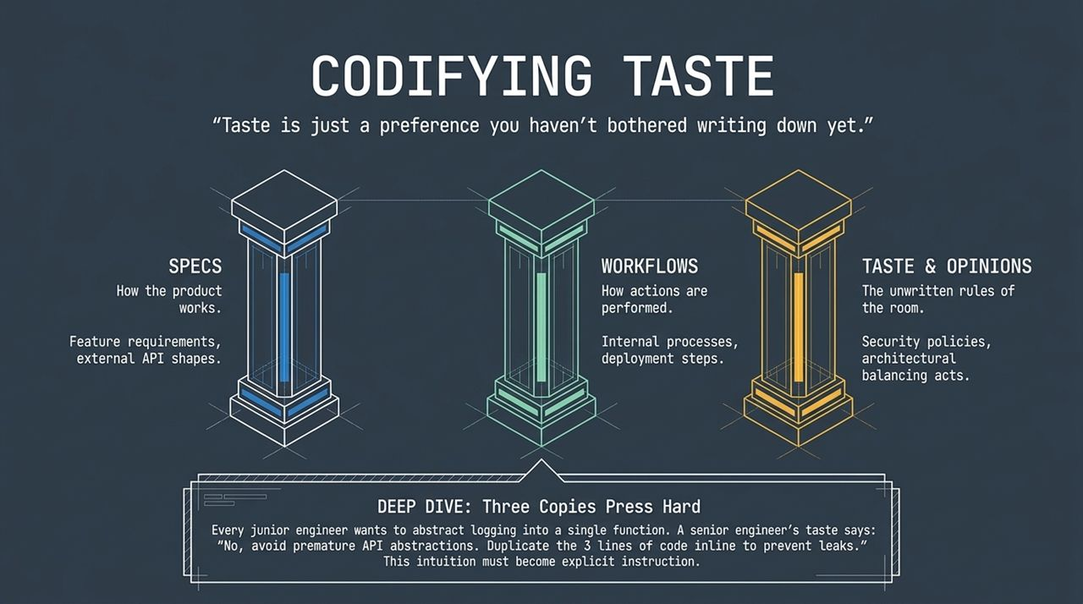
Notes:
As engineering leaders, your mindset must shift: You are no longer building the car. You are building the factory.
Action 01 — Defend the Factory: Scrutinize PRs today to prevent slop code from entering the repo. You must stop the bleeding (close the windows) before turning on the AI acceleration.
Action 02 — Extract the Exhaust: Every time a human developer leaves a review comment or corrects an agent PR, capture that trace exhaust. Convert those corrections into updated linter rules, agent instructions, and organization-wide skills.
Action 03 — Shift the Metric: Stop evaluating engineering throughput by position (lines of code written). Start measuring velocity—how rapidly your automated factory system improves its quality and delivery capabilities week-over-week.

Slide 10
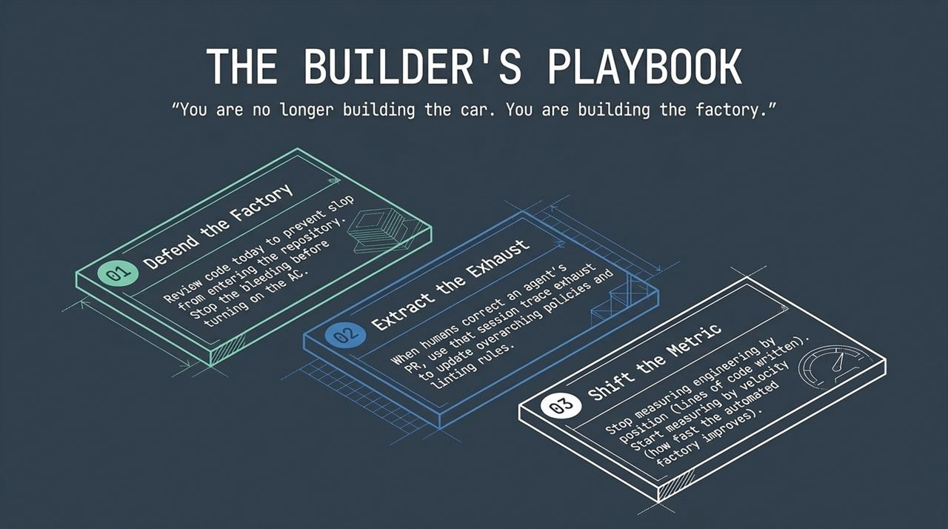
Notes:
As agentic coding infrastructure matures, organizations face a critical architectural decision: choosing between a Walled Garden vs. The Kubernetes Model (Open Stack).
The Walled Garden (Closed, Proprietary): Fully managed sandboxes and locked runtimes offer quick initial setup, but risk vendor lock-in and loss of long-term control over context and architecture.
The Kubernetes Model (Open Protocols): Modular dev-tool stacks, portable intent specifications, and open protocols. Just as Kubernetes won container orchestration, open dev-tool stacks will likely win software factory infrastructure.
Key Message: Do not mortgage your critical codebase to opaque, locked-in agent workflows. Preserve your team's taste and retain control over your underlying architecture.

Slide 11
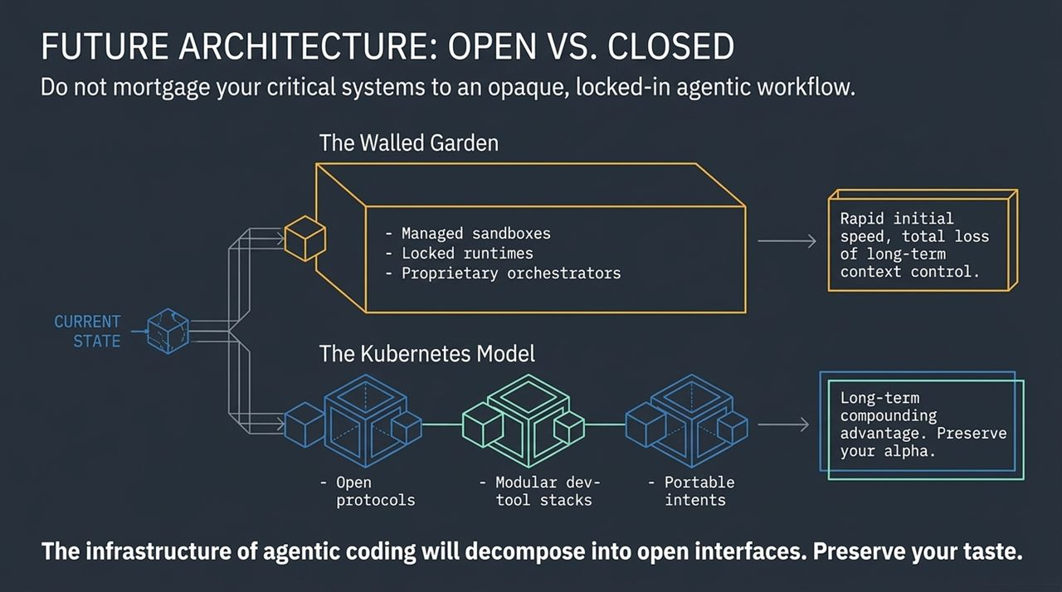
Notes:
Let's summarize the key takeaways:
The Hidden Cost of Autonomous AI: Unattended AI creates fragmented, overly complex architectures (Slop Code) that eventually become impossible to debug or maintain.
Optimizing the Factory:
Strategic Planning: Apply the context slider—strictly spec high-risk database schemas while allowing freedom on low-risk UI elements.
Codify Taste: Document your team's security standards and architectural preferences into explicit agent context.
Avoid the Dumb Zone: Prune context windows aggressively to maintain high reasoning accuracy.
Focus on Factory Velocity: Treat code review exhaust as feedback loops to continuously refine your software-building system.

Slide 12
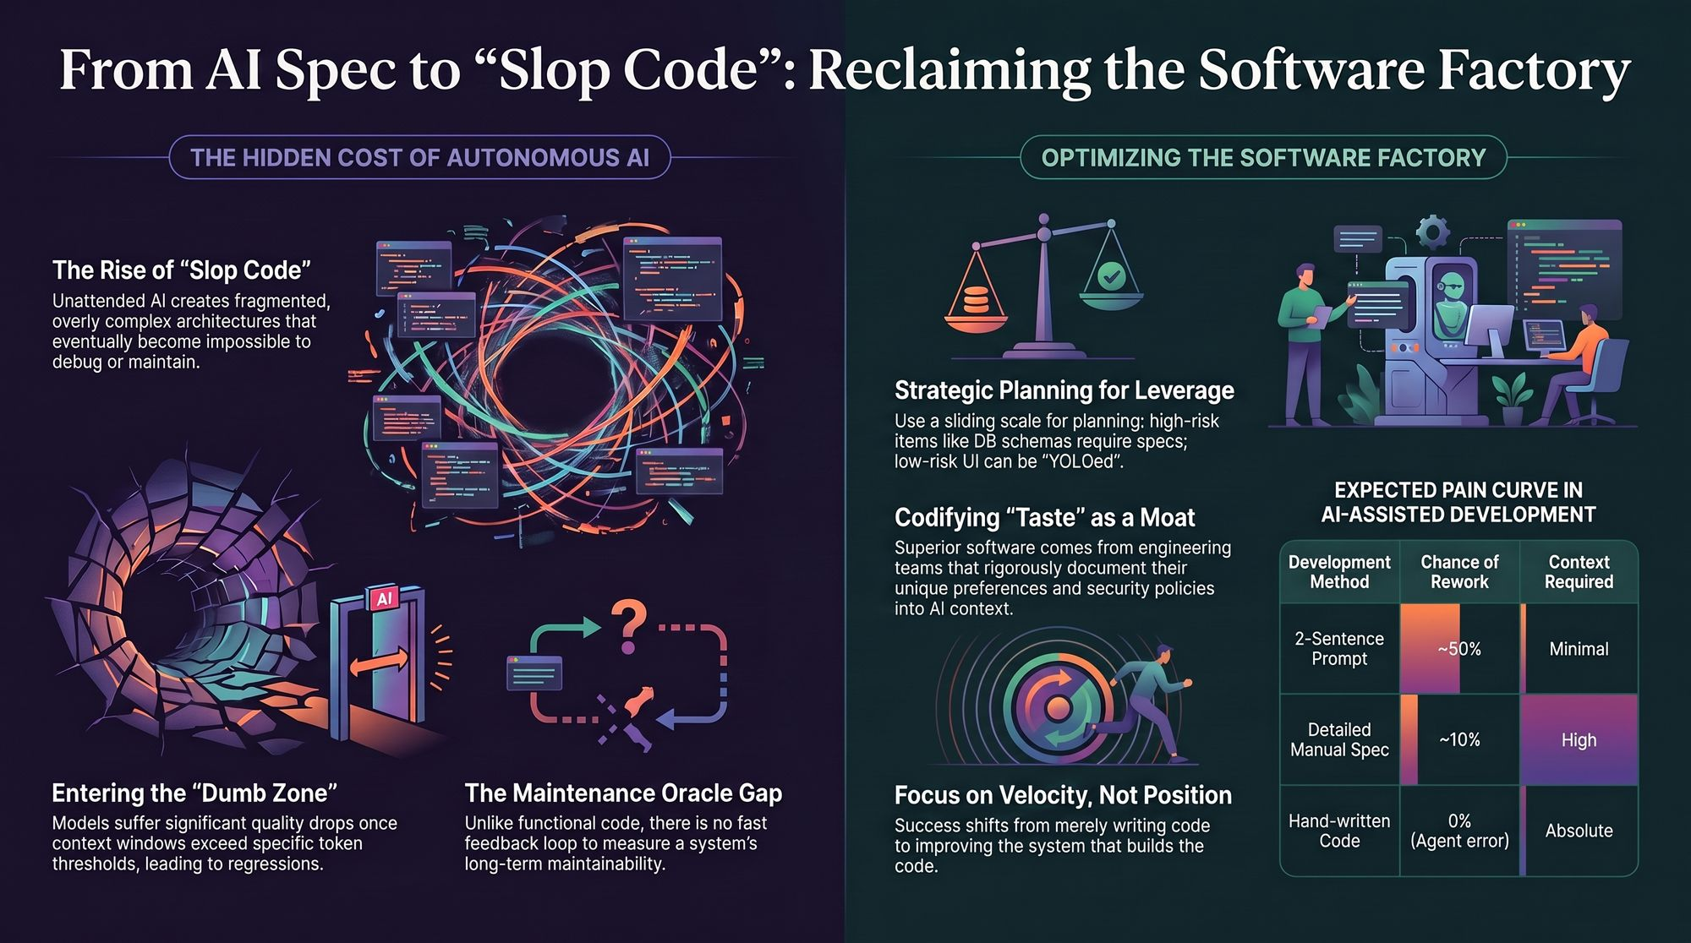
Notes:
We close with this reference matrix balancing Development Method vs. Chance of Rework vs. Required Context:
2-Sentence Prompt: ~50% Chance of Rework | Minimal Context Required
Detailed Manual Spec / AI-Assisted Plan: ~10% Chance of Rework | High Context Required (Optimal Leverage)
Hand-written Code: 0% Agent Error | Absolute Manual Effort
Thank you. Let's open the floor to Q&A on building resilient AI software factories.
Dexter Horthy (HumanLayer) on Why You Still Review AI Code
https://www.youtube.com/watch?v=H_1PygR7kwk

